Slide 1
Threat Modeling
Engineering Secure Software

Slide 2
Uses of Risk Thus Far
Start with the functionality
Use cases → abuse/misuse cases
p(exploit), p(vulnerability)
Start with what to protect
Goals → High-level Risks → Indicators → Tests
Assets
Domain, domain, domain
Today: start with threats

Slide 3
STRIDE
Spoofing
Tampering
Repudiation
Information disclosure
Denial of Service
Elevation of privilege
I am Spartacus.
Looks like Johnny got an A!
Didn’t Johnny have a B?
Johnny’s SSN is…
Please try again later.
sudo rm –rf /home/johnny

Slide 4
STRIDE ~> Security Properties
Kind of the inverse of security properties, but not fully
Tampering → Integrity violation
Repudiation → Integrity of the history violation
Information Disclosure → Confidentiality violation
Denial of service → Availability violation
Spoofing
Violating authentication
You are not who you say you are (e.g. session hijacking, guessing passwords)
Elevation of privilege
Violating authorization
You can access things you should not be allowed to access (e.g. permissions, network access)

Slide 5
Repudiation
A threat to the belief that integrity was preserved Didn’t Johnny have a B?
Provenance
Logs
Hash (digest) algorithms
Third-party verification
e.g. artwork, copyright registration
Ultimately, another type of integrity violation
…but not exactly a tampering threat
Protect against tampering? Filter access, etc.
Protect against repudiation? Keep a reliable history

Slide 6
Architectural Risk Analysis
Discuss security risk once most of the architecture is settled
Motivation: a few good early decisions goes a long way
e.g. incorporating encryption
e.g. authentication & access control concerns
e.g. choice of technologies used
Must-haves vs. Nice-to-haves at the design level
Emphasis of design flaws over code-level vulnerabilities
Note: “Risk Analysis” is not necessarily “Modeling”

Slide 7
Threat Modeling
Architectural risk analysis tool
Built at Microsoft, on top of Visio
STRIDE concept
Methodology:
Define a data flow diagram
Processes
External interactors
Data stores
Data Flows
Define trust & machine boundaries
Map STRIDE to each element & relationship

Slide 8
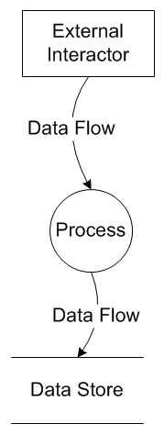
Data Flow Diagram Primitives
External interactors
e.g. clients, other systems, dependencies
Process
Architecture-centered functionality
e.g. dispatcher, input validator
Data store
e.g. database, file system
Data flow
Domain-specific explanation of data
e.g. “Login Requests”

Slide 9
Trust Boundaries
Draw trust Boundaries data from one party to another is not trusted
Untrusted examples
Data from a web browser (e.g. external interactor)
Data from one machine to another
Trusted examples
Data from another process within the same runtime
Data from the database

Slide 10
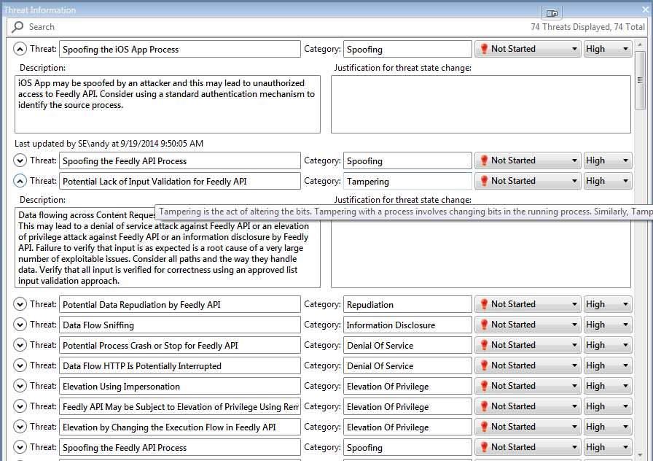

Slide 11
Analysis View
Generate potential threats that must be mitigated
Uses the structure and the test to
Forces you describe mitigations
Helps record assumptions
Go directly to file a bug
Threats are particularly bad when…
Flows cross boundaries
Lack of awareness for technology-specific issues (e.g. XML)

Slide 12
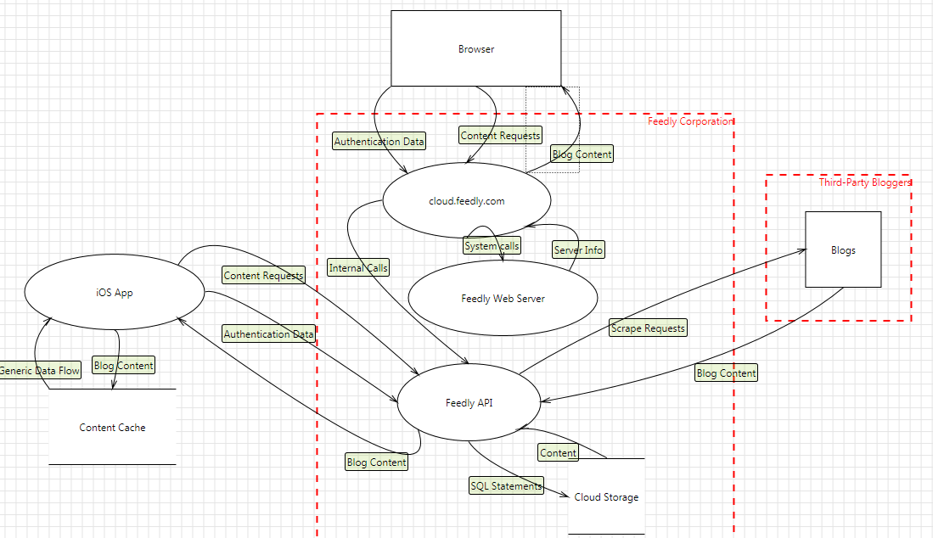
Example: Feedly

Slide 13
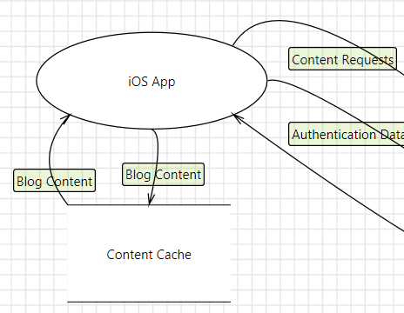

Slide 14


Slide 15
What’s Not in This Diagram
Third-party interactors for the Feedly API
Android, Windows apps
External API dependencies
e.g. Using libcurl to download blog content
Any others we can think of?

Slide 16
Threat Models != Architecture
Threat models are specifically about modeling security, not architecture
Architecture diagrams depict subsystems responsibility
Threat Model
Based on data flows
Naming and characterizing the data that will be transported from one part of the system to another
Iteratively mitigating risks the tool tells us about
Big architectures may end up being one big bubble
Small features in the architecture might constitute an entire process in a threat model

Slide 17
Tip: Naming Is Huge
Make your flows be meaningful
Bad: “HTTP”, “Request”
Good: “Blog Content”, “Scrape Requests”
Name your trust boundaries
Machine?
Corporate?
Network?
Processes & external interactors
Good: “feedly.com”
Bad: “server”
Ultimate test: outsiders should understand your system without much other info than the data flow diagram

Slide 18
More Tips for Threat Modeling
Be honest with the process
Make sure the model represents reality (or what you really believe reality will be)
Consider all types of threats – code-level vulnerabilities are just a “for example”
As with all modeling, use appropriate complexity
Overly-simplified?
Departs from reality
You get exactly what you put into it – no new knowledge
Overly-complicated?
Too much to analyze
“Check it off the list” syndrome
Test your model
Think of a specific security concern, then try to see where it fits in your threat model

